Slide 1
Volume and Capacity
Miss L
Year 11 Essentials

Slide 2
Learning Intentions
Students will be able to
calculate the volume and capacity of cubes and rectangular and triangular prisms

Slide 3
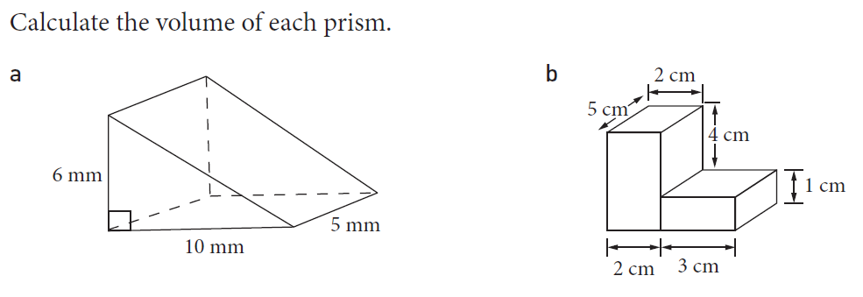
From Last Lesson

Slide 4
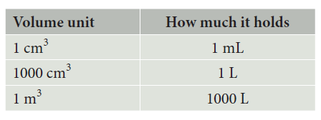
24
7
30
Volume and Capacity
Date
EQ – How do you work out the capacity of objects?
Remember from the first volume lesson

Slide 5


Slide 6
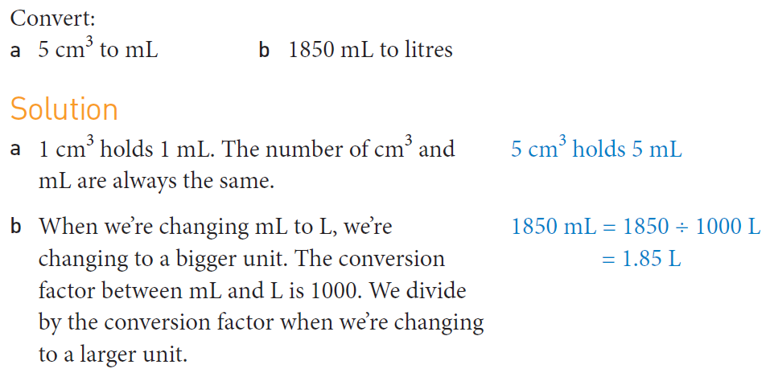
Practice

Slide 7
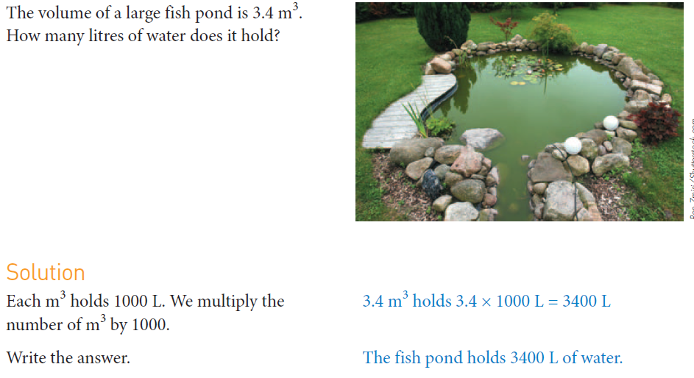

Slide 8
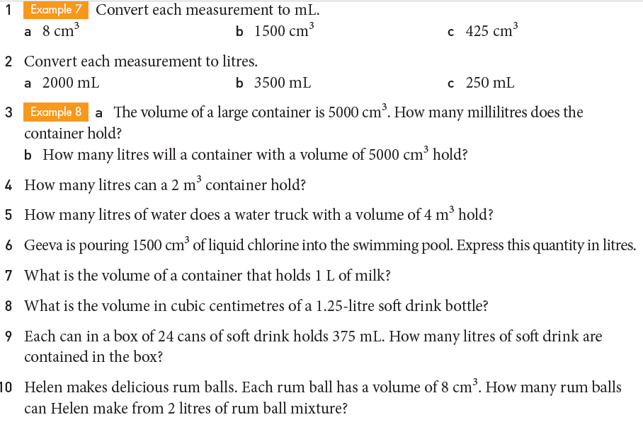
Task

Slide 9
